Slide 1

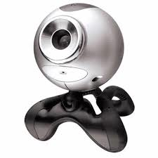
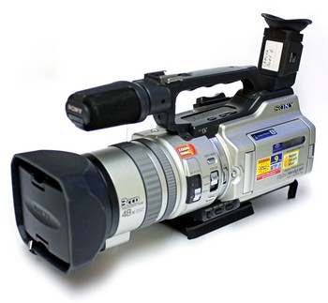

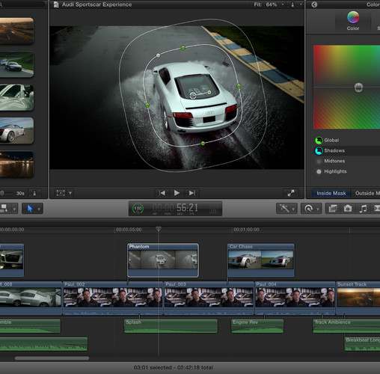
Video Compression
Rudina Alhamzi, Danielle Guir, Scott Hansen, Joe Jiang, Jason Ostroski

Slide 2
Digital Imaging History
Early Life
  NASA started working with digital imaging in the 1960s
  Space probes acquired signals
  Signals converted to images
  Other government sectors began to use this technology
Consumer Introduction
  Introduced to the consumer market in the mid 70s
  Kodak developed solid state image sensors
  Converted light into digital images
  1986 mega pixel sensing unit capturing 1.4 million pixels

Slide 3
Analog VS Digital (Hardware)
Analog
Shutter: Camera lets light in at desired time
Lens: Light enters and focuses onto film
Digital
Shutter: Mechanical shutter
Lens: Can override fixed focus

Slide 4
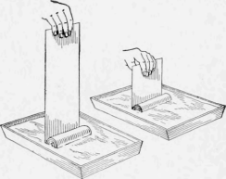
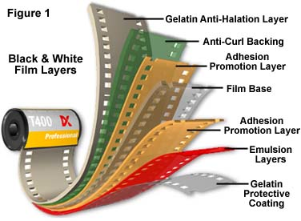
Analog VS Digital (Creating an Image)
Analog – Film is bathed in chemicals. The parts with least exposure are more transparent. Bright light shined through film that turns negative image into positive.
Digital – Converts digital reading from light sensor into an image

Slide 5
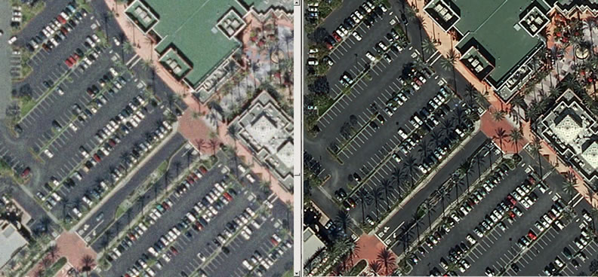
Analog VS Digital

Slide 6
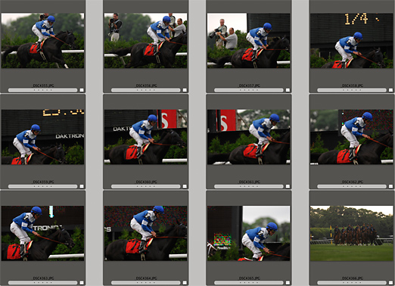

Frame Rate
Videos are a sequence of images played very quickly
FPS (Frames Per Second) - rate at which the images are displayed
  15 FPS - slowest rate the human brain will recognize as real movement
  30 FPS - Standard Definition Television
  25 - 60 FPS - High Definition Television
Higher frame rates can decrease motion blur from high speed objects

Slide 7



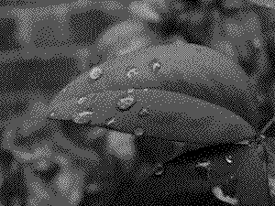

Pixels and Color Depth
Every frame of a video is a bitmap image
  Image is comprised of a raster of pixels
Pixels only have one property
  Color
Color Depth - Number of bits used to indicate the color of the pixel
  N bit color = 2^N Colors

Slide 8
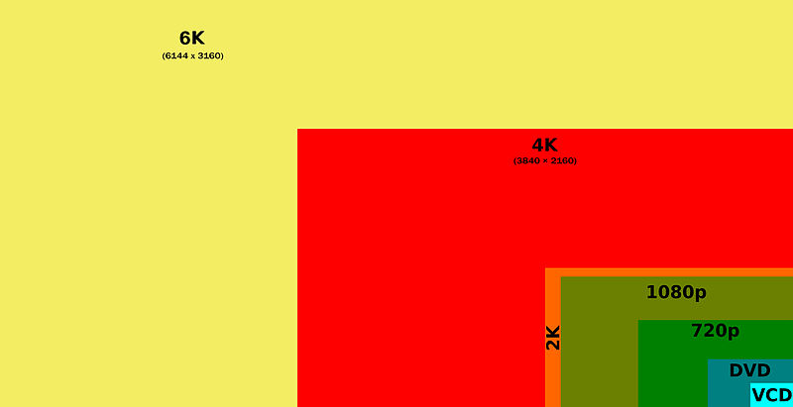
Resolution
Number of pixels in an image
  Width * Height
NTSC
  720 x 480
  345,600 pixels
HDTV
  1920 x 1080
  2,073,600 pixels
4K TV
  3840 x 2160
  8,294,400 pixels

Slide 9
Uncompressed Video Size
Video size = Width * Height * Color Depth * FPS * Time
Ex: NTSC Video, 24 bit color, 10 minutes
720 * 480 * 24 * 30 * 600 = 149,299,200,000 bits
149,299,200,000/8 bits per byte/(1024^3) bytes per GB
17.38 Gigabytes!
  Reduce Storage space
  Reduce Bandwidth
  Lowers Cost
  Easy to access videos

Slide 10
Compressed Video
The method used to reduce the amount of data, utilizing one of several strategies without negatively affecting the quality of the image
  Reduce Bandwidth
  Lowers Cost
  Easy to access videos
Types:
Lossless
Lossy
Major Variables correlating to file size :
Pixel dimensions
Frame rate (15-, 24-, 25-, 30 -fps)
Progressive or interlaced frames
Bit rate
Etc.
Considering video as a series of still frames
- Compression Methods (high level)
1.compressing each frame as a JPEG (M-PEG)
2. have a reference frame and a series of different frames
3. predictive/estimate motion

Slide 11







Video compression Standards
Different compression standards:
  MPG
  JPEG
  AVI
  MOV
  FLV
  WMV,
  real time, etc

Slide 12

AVI (Audio Video Interleave):
Audio and video data
Synchronous audio-video playback
AVI Can be used as a starting point to create playable DVD
Advantages
high rate compression
Disadvantages
Often produces larger file.
Excellent fidelity of the audio
Widely used
Choice of codecs allows experience with different results
Some codecs produce reduced visual quality.
Some codecs take a long time to create an AVI movie.
Notes:
AVI is an abbreviation for Audio Video Interleave. AVI file is a container of audio and video data that allows synchronous audiovisual playback. It is the oldest video format. There are a lot of AVI codec is created by both vendors and individuals. So now there are hundreds of AVI files that look similar but are completely different inside.
Disadvantages:
-Often produces larger file sizes than other file formats

Slide 13
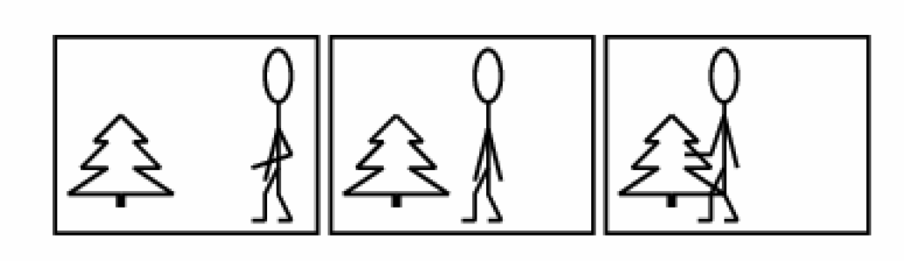
M-JPEG: (Joint Photographic Experts Group)
-a sequence made from a series of individual JPEG Images.
-16> frame per second.
Advantages:
Low complexity.
Constant image quality
Low latency (good for live video)
Resiliency
An unlicensed standard
Broad compatibility and popular in applications
Disadvantages:
High bandwidth consumption
High storage requirements
Notes:
Similar to a digital still picture camera, a network camera captures individual images and
compresses them into a JPEG format. The network camera can capture and compress, for
example, 30 such individual images per second (30 fps), and then make them available as a
continuous flow of images over a network to a viewing station. At a frame rate of about 16 fps
and above, the viewer will perceive full motion video. We refer to this method as Motion JPEG
or M-JPEG.
As each individual image is a complete JPEG compressed image, they will all have the same
guaranteed quality, determined by the compression level as defined for the network camera or
network video server.
Example

Slide 14
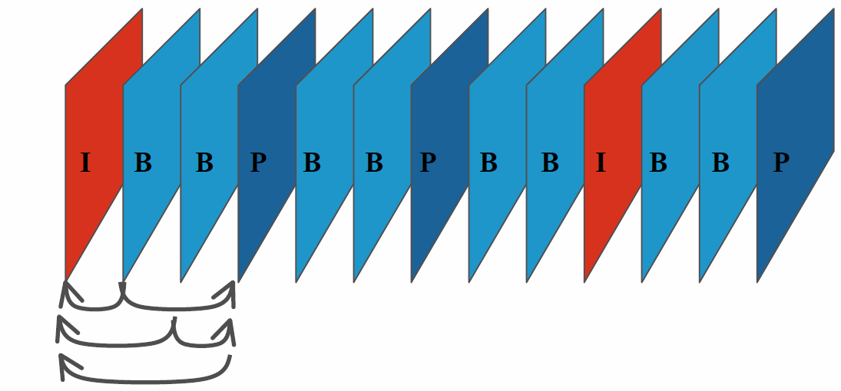
MPEG: (Moving Picture Expert Group)
MPEG-1, MPEG-2, MPEG-4
Compares two compressed images transmitted over network.
Notes:
Simply described, MPEG’s basic principle is to compare two compressed images to be
transmitted over the network, and using the first compressed image as a reference frame (called
an I-frame), only sending the parts of following images (B- and P-frames) that differ from the
reference image. The network viewing station will then reconstruct all images based on the
reference image and the “difference data” contained in the B- and P-frames.
A typical sequence of I-, B-, and P-frames may look as below. Note that a P-frame may
only reference a foregoing I- or P-frame, while a B-frame may reference both foregoing
and coming I- and P-frames:
At the cost of higher complexity, the result of applying MPEG video compression is that the
amount of data transmitted across the network is less than that of Motion JPEG. This is
illustrated below where only information about the differences in the second and third frames is
transmitted
I

Slide 15
MPEG2 and MPEG4:
Advantages:
Constant Frame rate
High compression: low bandwidth requirements
Low storage requirements and Reduces Processing power
Widely used for many applications
Disadvantages:
Consumes high processing power.
Complex compression.
Low robustness
Less resilient at packet loss
Licensing restrictions means no free viewers
Notes:
Advantages:
*Constant Frame rate:
if bandwidth availability goes down, frame rate is maintained at
the cost of image quality (benefits monitoring applications, but not
surveillance/recording applications).
encodes differences between frames in the video signal, therefore, frames are dependent on each other.
*Low storage requirements and Reduces Processing power
Similar quality with MJPEG, however Smaller storage space.
Frame rate fixed to 25/30 fps (only valid for MPEG-2)
• Complex compression: processing requirements on PCs performing decompression is
quite high (few channels can be shown live and off-line image analysis is slower)
• Low robustness: if bandwidth goes below a certain threshold all video is lost
• Higher latency: potential problem when monitoring live video, and PTZ control
• Poor transport protocol: designed for real-time viewing, not for recording and analysis
• Less resilient at packet loss: IBP frames need to re-sync and data is lost
• In CBR, image quality is lost with network congestion or movement in image scenes
• Licensing restrictions means no free viewers

Slide 16
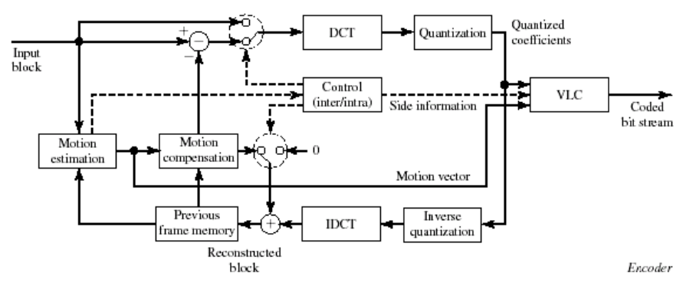
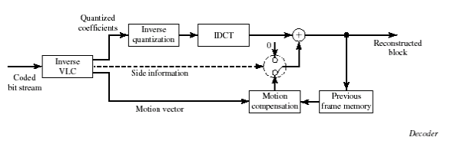
Codecs
A compression-decompression algorithm that looks for redundancy in data files.
Comprised of:
  Encoder
    Spatial & temporal encoder
    Motion estimation/compensation
  Decoder
Video containers (e.g. MP4, MOV, AVI)
- Codecs (size, speed, quality)
  Divx (corporation)/*Xvid (freeware)
  FFMpeg
  x264 (preferred for streaming)

Slide 17

Thank You!

Slide 18
Resources
http://documentation.apple.com/en/finalcutpro/usermanual/index.html#chapter=C%26section=12%26tasks=true
http://www.learningsolutionsmag.com/articles/1203/
http://www.edb.utexas.edu/minliu/multimedia/PDFfolder/CompressingDigitalVideo.pdf
http://broadcastengineering.com/storage-amp-networking/pixel-grids-bit-rate-and-compression-ratio
Y. Wang, J. Ostermann, Y. Q. Zhang,
Video Processing and
Communications,
Prentice Hall, 2002. Chapters 9,11,13
http://inst.eecs.berkeley.edu/~ee290t/sp04/lectures/video_coding.pdf
http://www.youtube.com/watch?v=NdBDeEoP74c
-- technical lecture
http://californiamapsociety.org/mapping/digital.php
https://files.nyu.edu/jac614/public/nyny/digital-cameras.html
http://hosting.collectionsaustralia.net/capture/course/sub9.html

